Slide 1
Derivatives Service Bureau UPI service overview
Emma Kalliomaki, DSB MD
Malavika Solanki, DSB Management Team
25th May 2021
Contact: otc.data@anna-dsb.com
© DSB 2021

Slide 2
Areas of focus
DSB Overview
UPI Availability Timeline
UPI Stakeholders
UPI Access and Workflows
UPI User Types and Suitability Assessment
User Number Estimates
Fee Model Determination Example
How to become a UPI service user
UPI Availability Timeline
Further Information
© DSB 2021
Page 2

Slide 3
1. DSB Overview
What is the DSB?
A technology platform which can generate an identification hierarchy for OTC derivatives
Within its scope of OTC derivatives, it provides the industry with an archive of International Security Identifier Numbers (ISINs) and their associated instrument reference data
It is global in design and operation, operated under the ISO principles including on a cost recovery basis
What does the DSB do?
ISIN, CFI and FISN generation for OTC derivative product as required by market participants
Distribution of OTC ISINs and their associated reference data to market participants
Access means include a web interface, programmatic connectivity and file download
Future generation of Unique Product Identifiers (UPIs) – from July 2022
Drivers
EU regulators have mandated that ISINs identify instruments for MiFID2 / MiFIR reporting, including some OTC derivatives
The DSB is the sole source of ISINs for OTC derivatives and was engineered to serve the needs of regulators and industry participants, to enable the industry to meet regulatory obligations
The DSB has been designated by the FSB as the sole UPI Service Provider and operator of the Reference Data Library
© DSB 2021
Page 3

Slide 4
1. DSB overview
Industry Stewardship
Product definitions and maintenance via industry-led Product Committee of market practitioners
Technology Advisory Committee formed to advise on future evolutions of the DSB technology platform to address changing market requirements
Public and transparent Industry Consultation process is open to all users to shape the evolution of the service
Third Party Assurance Audit - ISAE 3402 and AAF 01/06 Type I and Type II Reports
Equal Treatment
The DSB aims to ensure parity and efficiency in delivery of service which includes following standardised processes and procedures for all users of the DSB operating under the cost recovery service
The DSB utilises a common agreement to ensure equal treatment across all users. Any exceptions to the terms are only introduced on the basis that they can be consistently applied across all users without imposing a risk on the service
Page 4

Slide 5
1. Dsb overview
Cost Recovery
The numbering agency services will be provided on a cost-recovery basis
Reasonable and Non-Discriminatory (RAND) Access and Use
DSB ISINs and their associated data will have no licensing restrictions on usage and distribution for any purpose as part of the ISIN record
Access to the DSB archive for consumption of OTC derivative ISINs and associated reference data will be available for free to all registered organizations and users
Leveraging the Existing DSB Service Provision
Minimizing implementation and run costs for the DSB which in turn reduces the cost basis used to determine UPI annual user fees
Reduction of user’s own technology burden so that the several hundred institutions already connected to the DSB can overlay their UPI related workflows in a manner that is more integrated with their other OTC derivative reference data needs
Page 5

Slide 6
2. Upi availability timeline
As part of its Governance arrangements for the UPI, the FSB outlined high-level expectations for global UPI implementation planning.
It was recognized that jurisdictional implementation is likely to be staggered, occurring at varying speeds because of the independent decision-making processes and prioritization of initiatives in each jurisdiction.
Allowing for legal changes to be made and for Trade Repositories (TRs) and reporting entities to adapt, the FSB recommendation is that jurisdictions undertake the necessary actions relevant to their situation to implement the UPI technical guidance no later than the third quarter of 2022.
In preparation for UPI adoption and implementation by supervisory authorities, the DSB continues to work with the Regulatory Oversight Committee (ROC) and industry stakeholders to refine the requirements and framework for UPI integration.
© DSB 2021
Page 6
Notes:
The DSB currently facilitates access for a broad spectrum of users, including credit institutions, small brokerages, private wealth management firms, boutique asset managers, large, multi-segment and/or multi-market trading venues, derivatives houses from across the buy and sell-sides and universal-bank style sell-side institutions with multiple business segments within a single group holding structure

Slide 7
2. UPI availability timeline
# | DSB’s UPI Implementation Milestones | Date(s)
1 | 1st UPI Fee Model Consultation period | 11th Jan – 5th Mar 2021
2 | List of Product Templates published for user information | 30th Apr 2021
3 | Draft API and Connectivity Specifications (rules of engagement) published | 30th Apr 2021
4 | 2nd UPI Fee Model Consultation paper published | 10th May – 9th Jul 2021
5 | Final API and Connectivity Specifications (rules of engagement) + draft UPI Product Template documentation published | 30th Jun 2021
6 | Industry Feedback window closes for 2nd UPI Fee Model Consultation | 9th Jul 2021
7 | Responses to the 2nd UPI Fee Model Consultation published | By 30th July 2021
8 | UPI Fee Model Consultation Final Report published | 27th Sep 2021
9 | UPI Product Templates finalized and published (provisional date) | 30th Nov 2021
10 | UPI Legal Terms and Conditions Consultation (dates to be confirmed) | Q4 2021
11 | Legal Consultation Conclusions published (date to be confirmed) | Q1 2022
12 | Internal DSB Quality Assurance Testing of UPI Platform (date to be confirmed) | Q1 2022
13 | UPI User Acceptance and Integration Testing Commences + User on-boarding commences (date to be confirmed) | End Q1 2022
14 | UPI Production system available – live UPIs can be created and searched (date to be confirmed) | July 2022
© DSB 2021
Page 7

Slide 8
3. UPI stakeholders
© DSB 2021
Notes:
Key Principles
Cost recovery
Reasonable and non-discriminatory access and usage
Industry stewardship

Slide 9
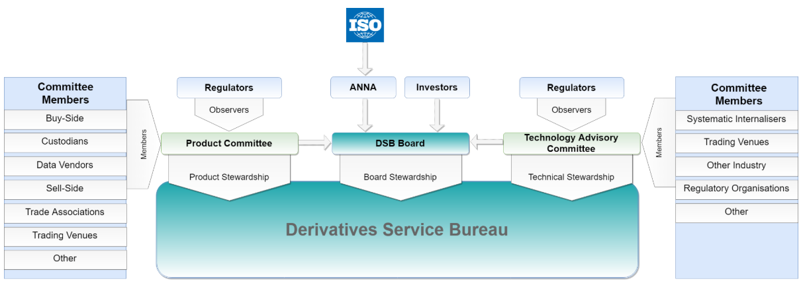
3. UPI stakeholders
DSB Governance
© DSB 2021

Slide 10
3. stakeholders: industry representation groups
Technology Advisory Committee (TAC) and the UPI specific TAC Strategy Subcommittee (TAC SSC)
Key areas of focus have been:
User scalability proposal
ReST Rules of Engagement (RoE) document updated to include new methods to support the UPI
FIX RoE documentation updated to include new methods to support the UPI
Workflows to support UPI Only, OTC ISIN Only and a combined UPI/OTC ISIN service
The primary/alternative underlier identifier requirements
The TAC is also establishing a new subcommittee with a focus on Cloud Architecture, following feedback from a previous OTC ISIN industry consultation
© DSB 2021

Slide 11
3. Stakeholders: industry representation groups
DSB Product Committee (PC)
The PC is focused on:
Retaining alignment between the CFI, UPI and OTC ISIN
Providing best practice guidelines to facilitate data alignment and consistency – in creation and use
UPI Product Definitions – principles, challenges and ongoing dialogue with the CDIDE
UPI implementation timeline and market education efforts
Enhancements to the OTC ISIN to support additional UPI data elements introduced in the draft UPI standard
Evolution of the FISN (human readable financial instrument short name) to cater for the UPI
CFI standard transition from the 2015 version to the 2019 version
© DSB 2021

Slide 12
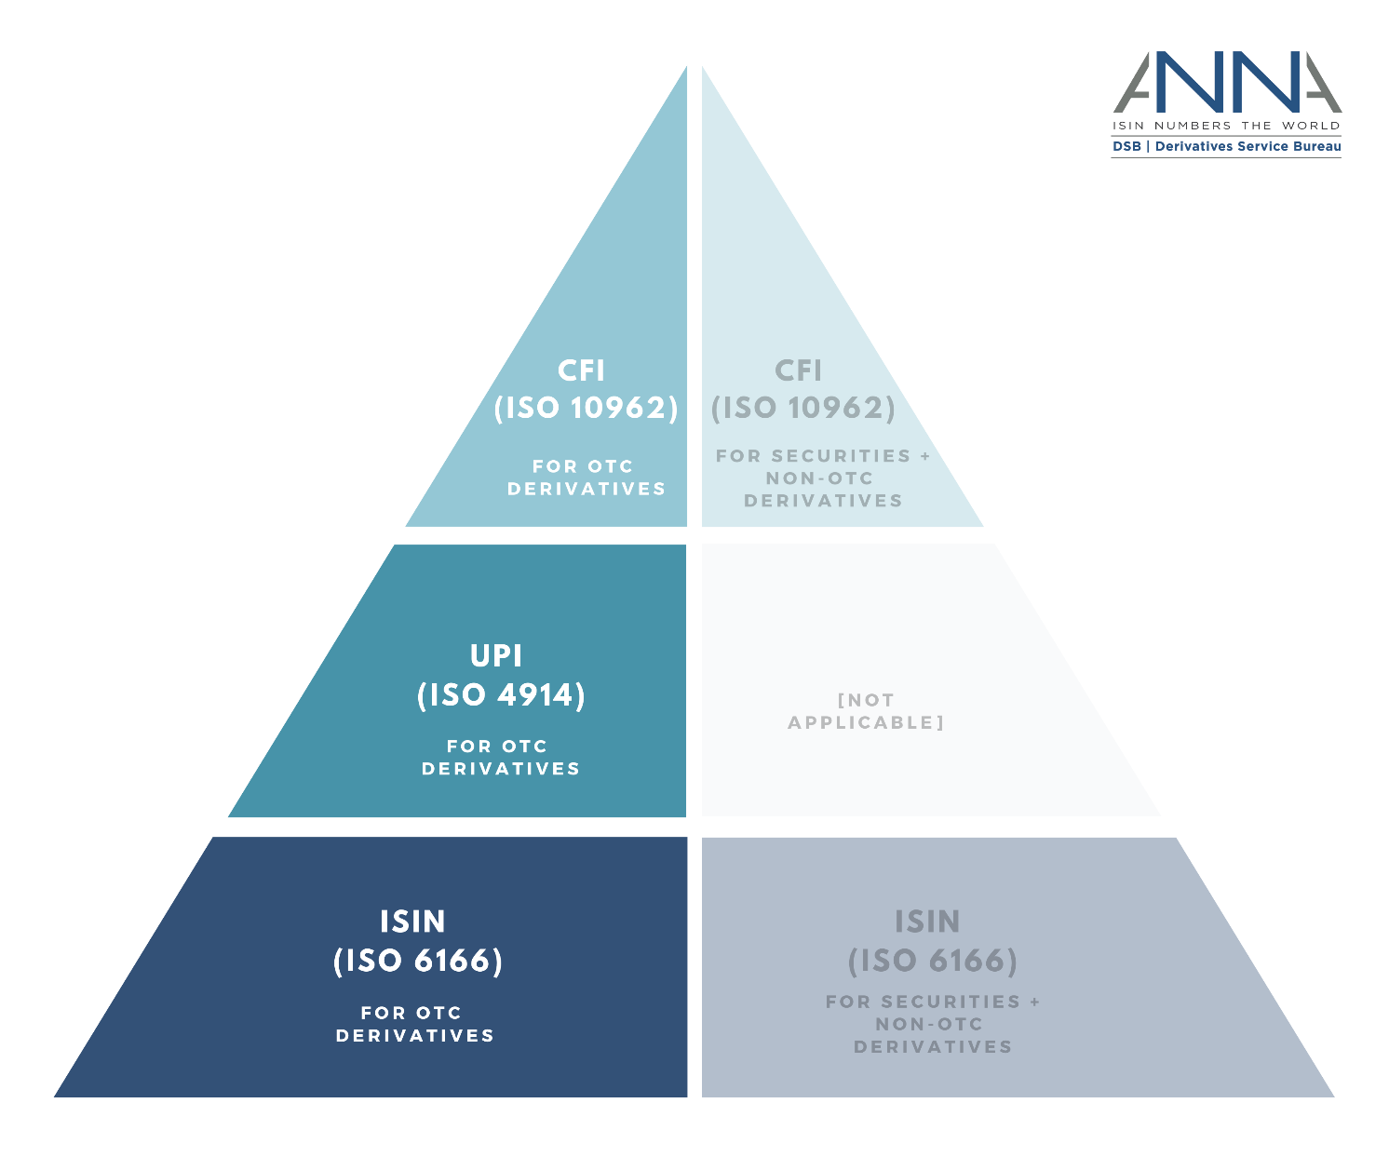
3. Stakeholders: iso standards
The UPI, currently being developed as an ISO standard (ISO/WD 4914), will sit within the suite of ISO standards provided by the DSB as a product level identifier, reflecting a subset of the data elements required for OTC ISIN
The DSB PC will determine the precise definition of each UPI record, so long as the minimum data elements set out by the ISO standard for UPI are satisfied
The PC therefore can determine whether any given UPI product definition should contain any additional data elements beyond those specified in the UPI ISO standard, if it determines that these additional data elements best represent the key feature set of the product
© DSB 2021
Page 12
Notes:
The preliminary review is complete and has sought to evaluate the data needs of the UPI in order to determine to what extent these were already held by the DSB when users were requesting an OTC ISIN and/or CFI code (as is expected to be the case for the large global financial services institutions).
The PC has subsequently been engaged in communications first with the FSB and now the ROC as part of its ongoing UPI related work and will undertake a detailed review of the full suite of UPI product definitions (for both input and derived values) so that implementation aspects can be finalised.
The PC is also examining any additional data sources that might be required to ensure global applicability of the identifier such as a sufficiently broad set of indices (across a range of asset classes, etc.).

Slide 13
3. Stakeholders: iso standards
The DSB PC has commenced a review of the alignment between the data elements contained in the OTC ISIN and the UPI as set out in the Technical Guidance Document published by CPMI-IOSCO
A key assumption is that the data elements contained in each of the CFI, UPI, and OTC ISIN will remain aligned
This approach is endorsed by the DSB PC as it allows market practitioners to readily understand the relationship between the various standards, and also more efficiently seek to create and/or search for data to assist with their global regulatory reporting obligations
The DSB PC will work with the ROC to resolve any concerns with respect to alignment of the CFI, UPI and OTC ISIN
It is expected that all OTC derivatives that are reportable to regulators could have one or more of the CFI, UPI and OTC ISIN – an approach supported by the DSB’s data architecture
© DSB 2021

Slide 14
3. Stakeholders: industry consultation
The first UPI Fee Model Consultation closed on 5 March 2021, responses are publicly available on the DSB website
The second UPI Fee Model Consultation opened 10 May and closes 9 July 2021. Highlights include -
A summary of responses from the first consultation for each question
A revision of user number projections based on feedback received to the consultation, as well as additional feedback received from ROC members with respect to UPI implementation plans
Questions relate to user estimates, forecast workflows for users, file download timing, cost projections and associated user fee estimates, cost allocation policy, user agreement duration, and the amortisation approach
The Final UPI Fee Model Consultation Report will be published on 27 September 2021
Consultation on the Legal Terms and Conditions is anticipated to open in Q4 2021
© DSB 2021

Slide 15
4. user access and workflows
DSB
Direct Connections
Web interface (manual, use)
Programmatic Interface (systematic, repeated use)
File Download (periodic publication of UPI records)
Market Participant
Via Intermediaries
© DSB 2021
Notes:
Experience with the OTC ISIN thus far indicates that many users have over time sought to connect directly to the DSB to supplement their reference data workflows for a variety of reasons, which include but are not limited to timeliness, efficiency, cost, etc.
The DSB proposes to facilitate access to the UPI service and the UPI reference data library on a programmatic basis, via a web front end, and via a file download service, with records available in a machine-readable format.
The DSB proposes to ensure that UPI users have access to the full suite of access mechanisms that are currently available to DSB users through the existing service. In addition, the DSB proposes to extend user access to include any new user types that are introduced in 2021, so that users are able to utilize the workflow that best meets their needs.

Slide 16
4. user access and workflows
UPI Users will be able to:
Create records
Search for records
Subscribe to receive newly created and/or updated records
Download individual records
Download regularly published delta files
The DSB will support 3 types of workflows:
CFI, FISN and UPI only
CFI, FISN, and OTC ISIN only
CFI, FISN, UPI, and OTC ISIN together (fully mapped data)
Users need to decide which of the above workflows they need before connecting to the DSB.
© DSB 2021
Page 16

Slide 17
4. user access and workflows
It is anticipated that the following data elements would be available in each scenario set out on the previous slide:
Organizations that only require access to the UPI and CFI – would obtain a UPI reference data record containing all input and derived data elements associated with the UPI
Organizations that only require access to the OTC ISIN, CFI and FISN (the current DSB service) – would obtain an OTC ISIN reference data record containing all input and derived data elements associated with the OTC ISIN
Organizations that require access to the full suite of UPI, CFI, FISN, and OTC ISIN – would obtain all the input and derived data elements that define each of the UPI, CFI and OTC ISIN
In each instance, the exact set of data elements returned by the DSB for each of the CFI, UPI, FISN, and OTC ISIN are subject to the criteria set out in the associated ISO standard and additional determinations made by the DSB Product Committee.
© DSB 2021

Slide 18
5. User types and suitability assessment criteria
Programmatically Connect:
High creation and search volumes in near real-time + subscribe to receive auto-updates + delta file download (typically addresses systematic need to mitigate operational risk)
Lower volume search-only in near-real time + delta file download (typically addresses need for systematic access for firms that wish to search but do not need to create)
Connect directly or via intermediaries (e.g. data vendors or technology platforms)
Manually Connect:
Low volume creation + search + data download (no/low systematic operational risk mitigation requirement)
Creation on an exceptional basis + search + data download (no systematic operational risk mitigation requirement)
Search-only + data download
© DSB 2021

Slide 19
5. user types
Within the DSB existing service provision, access is currently provided to users on the following basis:
Power User: programmatic connectivity for high volume creation + search (paid usage)
Search-only API User*: programmatic connectivity for lower volume systematic search (paid usage)
Standard User: manual creation and search for lower volume users, using a web-front end (paid usage)
Infrequent User: manual creation + limited search using a web-front end – targeted towards very low volume users, with a limit on the number of search results returned and an unlimited number of searches (paid usage)
Registered User: manual search services using a web-front end, with a limit on the number of search results returned and an unlimited number of searches, no creation possible (free to use)
*Search-only API User to be introduced from 1 January 2022
© DSB 2021
Notes:
Also mention that a user can have programmatic search to complement a manual creation method

Slide 20
5. user types
 | Registered User | Infrequent User | Standard User | Search-only API User | Power User
Programmatically Create | O | O | O | O | P
Manually Create | O | P | P | O | P
Programmatically Search | O | O | O | P | P
Manually Search | P | P | P | P | P
Subscribe to receive auto-updates | O | O | O | O | P
Download delta files | P | P | P | P | P
Download individual records | P | P | P | P | P
© DSB 2021

Slide 21
5. User types: open access data
Irrespective of user type, all DSB users will be able to:
Search for OTC derivative data in near real-time by logging on to the DSB’s web front end
Conduct a manual search and download the specific record of interest in machine readable format
Download machine readable records and have free of cost access to regularly published files containing a list of all new records created or updated in that period
Obtain the UPI derivative identifier from the counterpart with whom the trade was executed
Obtain the UPI derivative identifier from the trade execution platform on which the trade was executed
Once obtained, use the UPI as part of their subsequent post-trade workflows
© DSB 2021

Slide 22
5. User type: availability of delta files for download
Users of the combined CFI, FISN, UPI and OTC ISIN service can:
access free-to-access delta files (containing all new, expired, and updated records) will receive the file at 23.55hrs UTC, T+0 (i.e. daily)
The file will contain the UPI code alongside existing CFI, FISN, and OTC ISIN input and derived data elements
Users of the CFI and UPI only service can:
access free-to-access delta files the full UPI record (UPI code and UPI input and derived reference data) at T+1 23.55hrs UTC
This approach aims to balance user feedback to the first UPI fee model consultation with a target operating model that can (i) support the financial sustainability of the UPI service, (ii) provide a fair service for all jurisdictions, and (iii) ensure adequate demand for the three user scenarios laid in the earlier slides
© DSB 2021

Slide 23
6. user number estimates
Estimated number of organizations that might seek access to the DSB following launch of the UPI service. Expectations are based on regulatory surveys, informal market discussions and industry consultation
Lower threshold estimates:
500 organizations representing 3.5k legal entities expected to pay to connect programmatically to create and/or search for UPI records
2,500 organizations representing 16k legal entities expected to pay to connect manually to create UPI records
17,000 organizations representing 115k legal entities expected to connect free of cost to search for and/or download UPI records
Upper threshold estimates:
12,000 organizations representing 80.5k legal entities expected to pay to connect programmatically
8,000 organizations representing 53k legal entities expected to pay to connect manually
20,000 organizations representing 133.5k legal entities expected to connect free of cost
© DSB 2021
Page 23

Slide 24
7. FEE Model determination example
UPI annual user fees will be charged on a cost recovery basis.
Fee model variables are proposed to be used to determine the user fee per user type. Based on the existing DSB fee model structure, the variables to calculate the user fees will comprise the UPI Total Estimate Cost and user numbers per fee paying user type.
Based on the proposed model, the higher the number of users, the lower the fee per user.
In order to determine the annual fees, the first element is to set the Infrequent User fee as a fixed amount. The rationale for a fixed fee that it is high enough not to disadvantage those Standard or Power Users but low enough to be acceptable to Infrequent and small volume UPI creators.
Following determination of the Infrequent User fee, the Power and Standard User fees are calculated. The Power User fee is proposed to be three times greater than the Standard User fee which is consistent with the existing OTC ISIN service provision, based on the respective functionality and connectivity.
As with the existing OTC ISIN service fee model, the Standard Users fee is set to reflect the fact that such users are substantially cheaper for the DSB to support as the lack of a programmatic interface results in lower data throughput as well as lower infrastructure requirements.
© DSB 2021
Page 24

Slide 25
7. FEE Model determination example
Example as used in the second Fee Model Consultation Paper*, based on 3,000 fee paying users -
Fee Model Variable | Value | Example Annual Fee
UPI Total Estimate Cost | €8.3m
Number of Infrequent Users | 900 | €135
Number of Standard Users | 300 | €1,450
Number of Power Users | 1,800 | €4,300
Example figures are illustrative only.
Final UPI annual fee determination is contingent on actual user numbers and UPI Total Estimated Cost once known.
*Excludes Search Only API as demand currently unknown
Example based on 300 fee paying users -
Fee Model Variable | Value | Example Annual Fee
UPI Total Estimate Cost | €6.5m
Number of Infrequent Users | 90 | €150
Number of Standard Users | 30 | €11,400
Number of Power Users | 180 | €34,000
© DSB 2021
Page 25

Slide 26
8. How to become a dsb upi or upI + OTC ISIN user
Determine which of the service models you require
Determine the user type that will be applicable to you
Users needing the UPI (via the UPI only and UPI + OTC ISIN combined service) will need to complete legal and technical onboarding activities via a DSB on-boarding portal
Users should note that:
It is proposed that all UPI creators and API users will sign a common User Agreement, which will automatically roll (subject to a termination provision) at the end of each Gregorian calendar year, subject to industry feedback
© DSB 2021

Slide 27
8. How to become a dsb upi or upI + OTC ISIN user
Users joining the service at the time of UPI launch (in July 2022) will have an initial UPI User Agreement that is shorter than the standard 12-month period expected to apply in subsequent years, in order to align all subsequent User Agreements (UA) with the Gregorian calendar year. This is expected to result in a pro-rata initial fee to allow for the shorter duration
Service fees will be payable in advance in keeping with the existing operating model to ensure effective support of the UPI service. This advanced annual commitment offers the DSB more clarity in aligning fee levels with cost recovery whilst ensuring the economic sustainability of the UPI service with establishment of financial reserves, and for users, it provides improved ability to forecast their costs for utilising UPI services.
© DSB 2021

Slide 28
9. UPI availability timeline
# | DSB’s UPI Implementation Milestones | Date(s)
1 | 1st UPI Fee Model Consultation period | 11th Jan – 5th Mar 2021
2 | List of Product Templates published for user information | 30th Apr 2021
3 | Draft API and Connectivity Specifications (rules of engagement) published | 30th Apr 2021
4 | 2nd UPI Fee Model Consultation paper published | 10th May – 9th Jul 2021
5 | Final API and Connectivity Specifications (rules of engagement) + draft UPI Product Template documentation published | 30th Jun 2021
6 | Industry Feedback window closes for 2nd UPI Fee Model Consultation | 9th Jul 2021
7 | Responses to the 2nd UPI Fee Model Consultation published | By 30th July 2021
8 | UPI Fee Model Consultation Final Report published | 27th Sep 2021
9 | UPI Product Templates finalized and published (provisional date) | 30th Nov 2021
10 | UPI Legal Terms and Conditions Consultation (dates to be confirmed) | Q4 2021
11 | Legal Consultation Conclusions published (date to be confirmed) | Q1 2022
12 | Internal DSB Quality Assurance Testing of UPI Platform (date to be confirmed) | Q1 2022
13 | UPI User Acceptance and Integration Testing Commences + User on-boarding commences (date to be confirmed) | End Q1 2022
14 | UPI Production system available – live UPIs can be created and searched (date to be confirmed) | July 2022
© DSB 2021
Page 28

Slide 29
10. Further information
Unique Product Identifier (UPI) latest information: https://www.anna-dsb.com/upi/
UPI Timeline: https://www.anna-dsb.com/upi-implementation-timeline/
About the DSB Product Committee: https://www.anna-dsb.com/product-committee/
About the DSB Technology Advisory Committee: https://www.anna-dsb.com/technology-advisory-committee/
UPI Fee Model Consultation: https://www.anna-dsb.com/upi-fee-model-consultation-2021/
Contact: otc.data@anna-dsb.com
© DSB 2021

Slide 30
Thank you!
© DSB 2021

